Slide 1
Quiz Game Presentation

Slide 2
Introduction
A quiz is a form of game or mind sport in which players attempt to answer questions correctly. It is a game to test knowledge about a certain subject.
In some countries, a quiz is also a brief assessment used in education and similar fields to measure growth in knowledge, abilities, and/or skills.

Slide 3
Core Idea of Project
This game is coded in ‘C’ language which is general purpose language.
The game contains some general knowledge question list and ten questions come up at random to the player.
Each right answer will award score of 4 points and wrong answer cut down 1 point.
The name of highest scorer is stored separately.
We can search details of any player by his/her name.

Slide 4
Building Strategy
This is a small,simple and easy to use project developed in ‘C’ language.
We have created separate questions and answers text file for the project.
Here, we will select random 10 questions for every players using rand() function and seeded it with current time to get more randomness.
From the random number generated, we will create array of unique number.
Then, from that random number, we selected corresponding question number and answer.

Slide 5
Building Strategy (contd.)
We used Dev C++ to develop the project.
We have used different panel for the game which are:
Start Game
View Highest Score
Reset Score
Search Record
Help
Quit
We, have used Beep(x,y) inbuilt function to create sound.
We have included several header files which are needed to run this program.

Slide 6
Guide to Implement the Project
This Project is done in C language, so we need GCC Compiler to Compile and Run the Program.
In addition to this, we need question and answer text file in same folder where .c file is stored.
The program is executed as: First, main function is called, then we will input through file, we have all question on it.Then one by one question are displayed on console in random order.
User have four options through which he has to choose one correct options from it and if users enter the key which is not the part of the options, then it will not accept the character and we need to input it again.
This makes the application more personal and interactive for the user.

Slide 7
Future Scope and Modifications
We can add difficulty level in quiz as it goes on i.e. after some correct questions, difficulty level of questions increases.
We can create quiz test on basis of subjects like question division on basis of math, science, etc.
We can extend this project for quiz answer sheet checking for evaluation in schools.
We can have one-on-one challenge between two users.

Slide 8
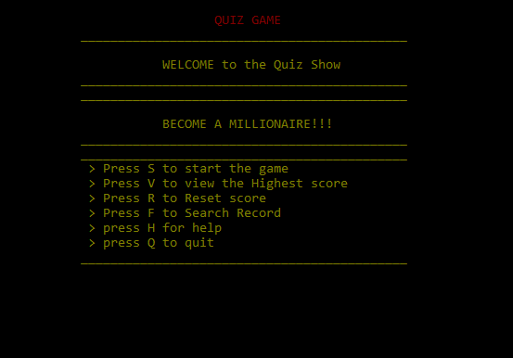
DEMO
Main Page:

Slide 9
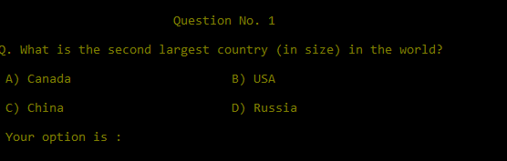
DEMO (contd.)
Quiz Question Page:

Slide 10
THANK YOU

